Slide 1


Slide 2
Mission
Who are we?
To Who ?
How ?
A shark conservation NGO resident in the Bahamas Islands that raises public awareness about sharks and works to reduce shark attacks.
Public/Private Organizations on Public Safety and Wildlife Preservation
By retrieving relevant data about species/location/victims and activities to evaluate the best approach.
Why ?
When ?
With 6.1 millions visitors in the 1st semester of 2026, avoiding attacks and reinforcing best practices regarding shark defense/preservation can lead to a better economy in the future.
During the sharks reproduction meeting and the touristic season.

Slide 3
Structure and Data Cleaning Process
Import Libraries | pandas, numpy, plotly.express and re.
Column Standardization | Standardizing headers into snake_case, dates into DD-MM-YYYY, values into .title() or .upper()
Stripping | Suffixes (st,nd,rd) , text markers (“Reported”), timestamps and spaces.
Filtering | Only incidents from 1976 - 2026 (last 50 years) in the Bahamas.
Conversion | Convert numerical time “00:00:00” into binary “Day/Night”.
Mapping | Standardize every highly granular columns by maping with dictionaries and regex.
Custom Columns | Added month, severity of the injury, incident status and geo location with coordinates
Data aggregation and Visualization | Created heatmap, bar charts and map plots.

Slide 4
Exploratory Data Analysis
Scope & Focus
Standardization
01
Analyze attack locations, activities, and severity.
Scope strictly to The Bahamas.
02
Create mappings for States, Location, Species, Activities, Injuries.
Cross-Refining to deduce missing details across related columns
Standardize data using np.select(), raw strings, .map(), .replace(), and .loc[].
Enrichment
Analysis
03
Add geocodes, severity tiers, and targeted body parts.
Drop irrelevant rows and non-essential columns (sources, GDPR data).
04
Explore the cleaned dataset to identify key patterns and insights.

Slide 5
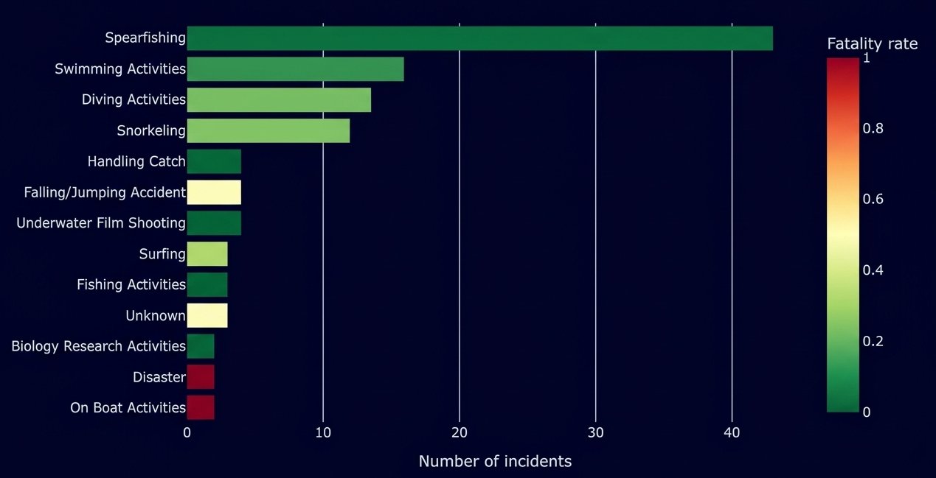
Incidents by Activity
Spearfishing has the highest number of incidents but one of the lowest fatality rates accounting 2 fatalities, against Falling/Jumping Accident with 50% fatality rate on 4 Incidents and Surfing with 33,3% on 3 Incidents.

Slide 6
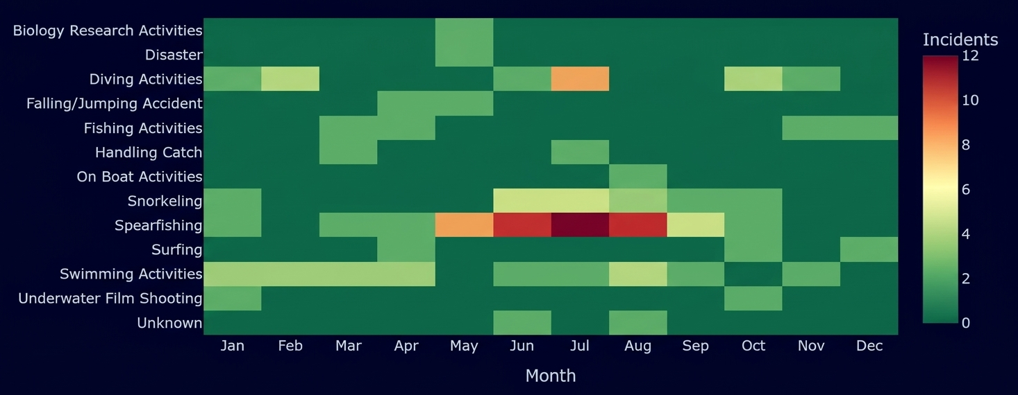
Incidents by Activity/Season and Daytime
Daytime
Day
Night
Incidents
97
2
Fatality
11
1

Slide 7
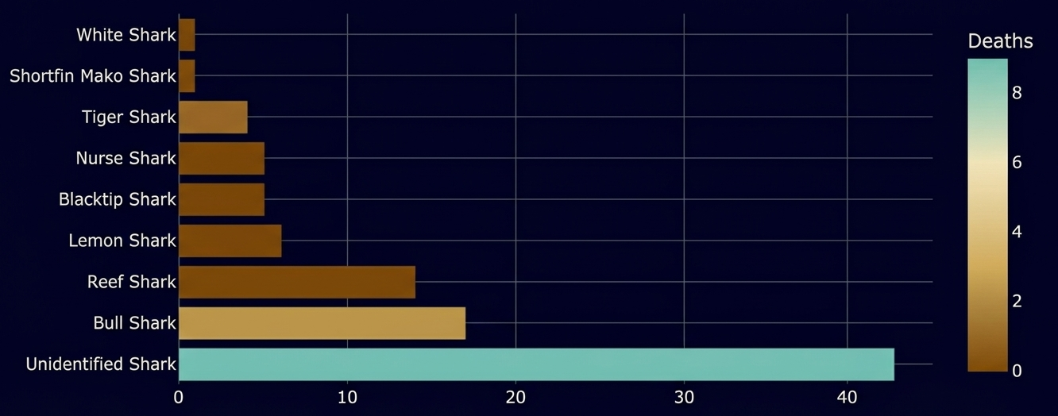
Incidents by Shark Species
Unidentified Shark attacks are most prevalent in victims due to the chaotic nature of a shark attack.
To contrary belief white sharks are not the common denominator in the Bahamas, this specie only habits deep sea waters, contrary to bull, reef, blacktip, tiger and nurse sharks that live in shallow tropical waters near the coast lines.

Slide 8
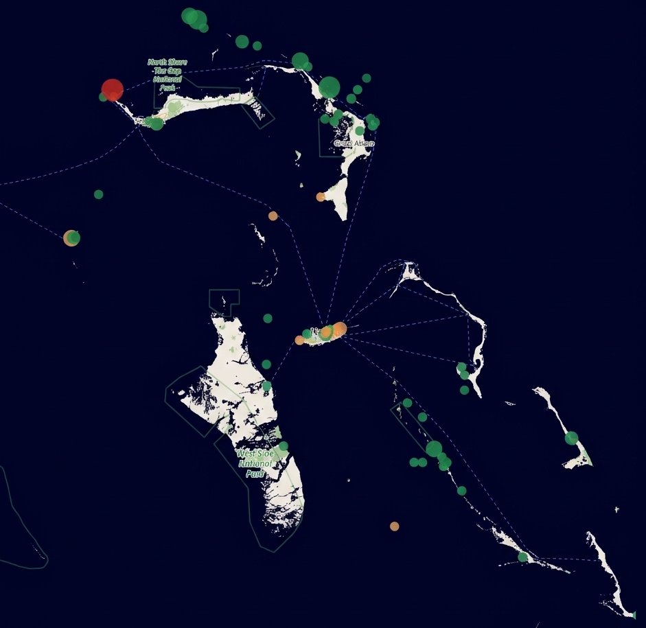
Incidents by Location
Analyzing each incident geolocation we can see a pattern near:
“Green Turtle Cay”
“Grand Bahamas”
“Great Abaco”
In these areas the fatalities are more probable not by the nature of the activity but by the amount of people doing it like we saw on the previous data regarding spearfishing.
Circle Size - Number of Incidents
Circle Color - Severity

Slide 9
Major Obstacle and Key Takeaway
Due to the small Bahamas dataset and high granularity, traditional filtering risked losing relevant data, requiring a defensive approach to preserve correlated values.
For the future drop irrelevant columns and format raw columns (e.g. dates, demographics, species) and split combined fields (e.g. injuries, names).

Slide 10
Conclusion
Night and deep-sea incidents have higher fatality rates than shallow-water encounters during the day. While spearfishing near the reefs accounts for the most incidents its mortality rate is relatively low.
Carrying defensive equipment to maintain distance or deter a shark attack can significantly improve survival odds.
Our data indicates that vigilance must be prioritized in the northern Bahamas above any other region.
Ultimately, the goal is to protect both humans and marine life while promoting safety strategies for peak tourist season.

Slide 11
THANK YOU!

